Slide 1
Memory Management
Ramachandran & Leahy, Chapters 7 & 8

Slide 2
So far
Software | Hardware
High level language + compiler + linker | ISA, addressing modes, stack, registers
Program discontinuities (INT handler in OS) | Interrupt support, processor implementation (simple + pipeline)
OS process scheduler + loader | Process as an abstraction, context switching
OS memory management | Hardware support for memory management

Slide 3
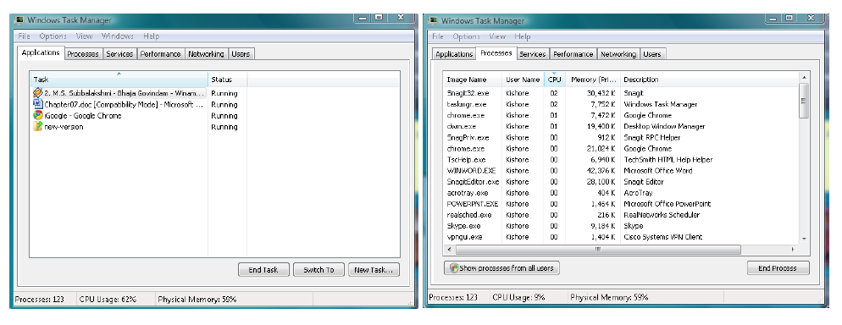
A “small” laptop’s workload
4 applications
123 processes!
1208MB of 2GB memory in use

Slide 4
Goals of memory management
What functionalities do we want to provide?
Improved resource utilization
Independence and protection
Liberation from resource limitations
Sharing of memory by concurrent processes
So far there’s no hardware in the LC-2200 to “manage” memory

Slide 5
Nothing in LC-2200 to manage memory
Address
Memory
CPU
Data
Memory bus

Slide 6
What’s missing in LC-2200?
OS
CPU
P1
P1 is running
Memory bus
P2
P3
Nothing to protect the OS, P2, and P3 from P1
No way to move P1 – it knows where it is loaded in memory
Can’t run more processes than we have memory for
Memory use is exclusive to a process

Slide 7
To manage memory…
Introduce a broker
B
R
O
K
E
R
CPU
Memory
CPU generated
Address
Memory
Address
So is the broker hardware or software??
Combination: management (a.k.a policy) → software mechanism → hardware

Slide 8
Simple management
One user process at a time
Separation needed between OS and user program
Fence register
Memory
Kernel
Low
Y
CPU
>
User
CPU generated
Address
N
Memory
Address
High
But modern operating systems are multiprogrammed!
Trap
Hardware mechanism
(new register in hardware: FENCE)

Slide 9
Fence register example
Provide protection for the OS
Performed by hardware without help from the CPU
Fence register
0x2FFF
Memory
Kernel
Low
Y
0x2FFF
CPU
>
User
CPU generated
Address
N
Memory
Address
High
Trap
If the CPU is in “kernel” state, execute the memory operation
Else if address is >= 0x3000, execute the memory operation
Else cause a “memory protection violation” trap

Slide 10
Multiprogrammed OS
Separation of address space for each process
Memory
Low
Kernel
Lower bound
Upper bound
P1
LB_{P1}
UB_{P1}
.
.
.
.
Y
Y
CPU
>
<
CPU
Address
N
N
Memory
Address
P1 is running
Trap
Trap
P2
Hardware mechanism
(new registers: LB, UB)
Pn
High

Slide 11
Bounds registers example
Separation of address space for each process
Memory
Low
Kernel
0x2FFF
Lower bound
0x2FFF
Upper bound
0x3101
P1
0x3101
.
.
.
.
Y
Y
CPU
>
<
CPU
Address
N
N
Memory
Address
P1 is running
Trap
Trap
P2
If the CPU is in “user” state and address is <= 0x2fff and
address is >= 0x3101, trap on address violation
Else execute the memory operation
Pn
High

Slide 12
Multiprogrammed OS
Separation of address space for each process
Memory
Low
Kernel
Lower bound
Upper bound
P1
LB_{P2}
UB_{P2}
.
.
.
.
Y
Y
CPU
>
<
CPU
Address
N
N
Memory
Address
P2 is running
Trap
Trap
P2
Hardware mechanism
(new registers: LB, UB)
Pn
High

Slide 13
Bounds registers example
Separation of address space for each process
Memory
Low
Kernel
0x2FFF
Lower bound
0x2FFF
Upper bound
0x3101
P1
0x3101
.
.
.
.
Y
Y
CPU
>
<
CPU
Address
N
N
Memory
Address
P1 is running
Trap
Trap
P2
If the CPU is in “user” state and address is <= 0x2fff and
address is >= 0x3101, trap on address violation
Else execute the memory operation
Pn
High

Slide 14
Bounds registers example
Separation of address space for each process
Memory
Low
Kernel
Lower bound
0xD9FF
Upper bound
0xE801
P1
.
.
.
.
Y
Y
CPU
>
<
CPU
Address
N
N
Memory
Address
P2 is running
0xD9FF
Trap
Trap
P2
If the CPU is in “user” state and address is <= 0xD9ff and
address is >= 0xE801, trap on address violation
Else execute the memory operation
0xE801
Pn
High

Slide 15
What needs to happen to ensure that LB and UB correspond to the currently running process?
Restore LB and UB to the system stack
Restore LB and UB to values defined in the source code file
Restore LB and UB to values from the PCB
Calculate LB and UB from the process-id
The number of the day is 36,040.
10

Slide 16
PCB
enum state_type {new, ready, running, waiting, halted};
typedef struct control_block_type {
enum state_type state;
address PC;
int reg_file[NUMREGS];
struct control_block *next_pcb;
int priority;
address memory_footprint; ????
….
….
} control_block;

Slide 17
PCB
enum state_type {new, ready, running, waiting, halted};
typedef struct control_block_type {
enum state_type state;
address PC;
int reg_file[NUMREGS];
struct control_block *next_pcb;
int priority;
address LB;
address UB;
….
….
} control_block;

Slide 18
“Management” by the OS
LB
At load time (loader)
Place P1 in memory
Set LB and UB in the PCB
At context switch time (dispatcher)
Load LB and UB from the PCB into the new CPU registers
P1
UB
P1
Mem

Slide 19
Limits of “bounds register” mechanism?
Relocation isn’t possible
Swapping-in can be a problem
OS
1000
dormant
P1
2000
P2
swap
3000

Slide 20
Limits of “bounds register” mechanism?
Relocation isn’t possible
Swapping in is a problem
OS
1000
P3
2000
P2
P1
P1 swapped out
3000
P2 finishes

Slide 21
Limits of “bounds register” mechanism?
Relocation isn’t possible
Swapping in is a problem
OS
1000
P3
2000
P1
P1
P1 swapped out
3000
We need to bring P1 back into memory
Where?
We have an empty spot…
Will this work?

Slide 22
Can we move an LC-2200 process?
When do we lock-in memory addresses?
At assembly/link time ➔ called static relocation
P1 can only be in memory between 1000 & 2000
That gives us poor memory utilization
i.e. not dynamically relocatable
So the program must be loaded into the address range into which it was linked. There’s no way we could move it later.
How about we forbid absolute addresses in our program code?
It would be relocatable at load time

Slide 23
Can we make P1 dynamically relocatable?
Don’t hard code addresses in executable
Set memory bounds at load time rather than link time
This implies making all addresses relative to some base register or the PC
But what happens when we execute
LEA
JALR
… Memory addresses get saved in registers!
Where can they be copied or modified from there?
Can we find them so we can fix them?
This is why we’d say the LC-2200 code is not dynamically relocatable
You still can’t move LC-2200 code once it’s started to run
IBM did this in System/360, but the CDC 6600 didn’t…

Slide 24
But there’s a hardware solution…
Dynamically relocatable multiprogrammed OS
Memory
Low
Kernel
3000
Base
Limit
P1
4000
BASE_{P1}
LIMIT_{P1}
.
.
.
.
Y
CPU
+
<
CPU
Address
N
Memory
Address
P1 is running
Trap
P2
Hardware mechanism
(new registers: BASE, LIMIT)
Pn
High

Slide 25
But there’s a hardware solution…
Dynamically relocatable multiprogrammed OS
Memory
Low
Kernel
3000
Base
Limit
P1
BASE_{P2}
LIMIT_{P2}
4000
.
.
.
.
Y
CPU
+
<
CPU
Address
N
Memory
Address
P2 is running
12000
Trap
P2
13000
Hardware mechanism
(new registers: BASE, LIMIT)
Pn
High

Slide 26
Base & limit register example
Memory
Program 1 uses addresses
0 - 1000
Low
Kernel
3000
Base
3000
Limit
4000
P1
4000
.
.
.
.
607
3607
Y
3607
CPU
+
<
CPU
Address
N
Memory
Address
P1 is running
Trap
P2
If CPU is in user state, add Base to address
If address < Limit, execute the operation
Pn
High

Slide 27
Base & limit register example
Memory
Program 2 uses addresses
0 - 1000
Low
Kernel
Base
12000
Limit
13000
P1
.
.
.
.
607
12607
Y
12607
CPU
+
<
CPU
Address
N
Memory
Address
P2 is running
12000
Trap
P2
If CPU is in user state, add Base to address
If address < Limit, execute the operation
13000
Pn
High

Slide 28
PCB
enum state_type {new, ready, running, waiting, halted};
typedef struct control_block_type {
enum state_type state;
address PC;
int reg_file[NUMREGS];
struct control_block *next_pcb;
int priority;
address memory_footprint; ????
….
….
} control_block;

Slide 29
PCB
enum state_type {new, ready, running, waiting, halted};
typedef struct control_block_type {
enum state_type state;
address PC;
int reg_file[NUMREGS];
struct control_block *next_pcb;
int priority;
address BASE;
address LIMIT;
….
….
} control_block;

Slide 30
The previous example with BASE + LIMIT
Now all of P1 and P2’s addresses appear to start at zero
This is our first instance of a virtual address where the process sees memory addresses different from the physical addresses we’ve been working with so far!
OS
P1 sees virtual addresses 0 – 999
P1 uses physical addresses 1000-1999
1000
dormant
P1
2000
P2
swap
3000

Slide 31
The previous example with BASE + LIMIT
Now all of P1 and P2’s addresses appear to start at zero
This is our first instance of a virtual address where the process sees memory addresses different from the physical addresses we’ve been working with so far!
OS
1000
P3
2000
P2
P1
3000
P2 finishes

Slide 32
The previous example with BASE + LIMIT
Now all of P1 and P2’s addresses appear to start at zero
This is our first instance of a virtual address where the process sees memory addresses different from the physical addresses we’ve been working with so far!
OS
P1 sees virtual addresses 0 – 999
P1 uses physical addresses 2000-2999
1000
P3
2000
P1
3000
We need to bring P1 back into memory
Where?
We have an empty spot…
Will this work?
It will if we set BASE & LIMIT to 2000 & 3000

Slide 33
To support dynamic relocation on the LC-2200, we would need…
Fence register
Base + Limit registers
Bounds registers
LC-2200 works just fine as it is
Today’s number is 24,987
20

Slide 34
Recap
Hardware | Software
Fence register | User/kernel split
Bounds register | Static relocation
Base + limit register | Dynamic relocation
Next
Allocation policies
Paging

Slide 35
Memory allocation by OS
Fixed size partition
Variable size partition
Both use the hardware base + limit registers

Slide 36
Fixed size partitions
memory
OS memory manager allocation table
5K
Occupied bit
Partition Size
Process
0
5K
---
8K
0
8K
---
Struct AT_entry {
int occupied;
int size;
int pid;
};

Slide 37
P1 needs 6K of memory
Memory
Allocation table
5K
Occupied bit
Partition Size
Process
0
5K
---
6K
1
8K
P1
2K

Slide 38
P1 needs 6K of memory
Allocation table
Table size is fixed = number of partitions
Memory
5K
Occupied bit
Partition Size
Process
0
5K
---
6K
1
8K
P1
2K
Needs only 6K

Slide 39
Another process needs 6K memory
Internal fragmentation = size of partition – actual used
Allocation table
Memory
5K
Occupied bit
Partition Size
Process
0
5K
---
6K
1
8K
P1
2K
Wasted
(internal fragmentation)
Needs only 6K

Slide 40
Another process needs 6K memory
Do we have it?
Memory manager has only a 5K partition…
Not possible
Allocation table
Memory
5K
Occupied bit
Partition Size
Process
0
5K
---
6K
1
8K
P1
2K

Slide 41
External fragmentation
Consider P3 that needs 4K of memory
Is it possible to allocate?
Memory is available, but not contiguous
Allocation table
Memory
1K
Occupied bit
Partition Size
Process
2K
1
1K
P1
0
2K
---
3K
1
3K
P2
0
2K
---
2K
External fragmentation
= ∑ All non-contiguous free memory partitions
And we have 4K of non-continuous memory here
Which gives us 4K of external fragmentation

Slide 42
Fragmentation
Internal fragmentation
Size of partition – actual memory used
External fragmentation
∑ All non-contiguous free partitions
If there is only one free partition, we say the external fragmentation is zero

Slide 43
Fixed size partition memory management
Virtues
Simplicity
Bad news
Fragmentation
Internal
External

Slide 44
Total internal fragmentation is…
Memory
Allocation table
2K
Occupied bit
Partition Size
Process
3K
1
5K
P2 (need 2k)
6K
1
8K
P1 (need 6K)
2K
2K
3K
5K
8K
23

Slide 45
Total external fragmentation is…
Memory
Allocation table
2K
Occupied bit
Partition Size
Process
3K
1
5K
P2 (need 2k)
6K
1
8K
P1 (need 6K)
2K
0K
2K
5K
8K
27

Slide 46
Overcoming internal fragmentation
Allocate exactly what is needed
Variable size partitions

Slide 47
Variable size partitions
memory
Memory manager allocation table
Start address
Size
Process
0
13K
FREE
13K
Struct AT_entry {
int start;
int size;
int pid;
};

Slide 48
Partition table a little while later
Memory
Grows and shrinks as partitions get created and released
Allocation table
Start address
Size
Process
11K
0
2K
P1
2K
6K
P2
2K
8K
3K
P3
11K
2K
FREE

Slide 49
P1 exits
Memory
Allocation table
2K
Start address
Size
Process
9K
0
2K
P1 -> FREE
2K
6K
P2
2K
8K
3K
P3
New request:
P4 needs 4K
Possible?
11K
2K
FREE
External fragmentation

Slide 50
P2 exits
Memory
Allocation table
2K
Start address
Size
Process
9K
0
2K
FREE
2K
6K
P2 -> FREE
2K
8K
3K
P3
11K
2K
FREE

Slide 51
Coalescing two free areas
Memory
Allocation table
Start address
Size
Process
8K
0
8K
FREE
3K
8K
3K
P3
2K
11K
2K
FREE

Slide 52
Reducing external fragmentation
First fit algorithm
A little quicker
Best fit algorithm
A little better memory utilization
Next fit algorithm
A little less space efficient in the average case
A little quicker than first-fit

Slide 53
Compaction
Request for 9K
Memory
Allocation table
2K
Start address
Size
Process
6K
0
8K
FREE
3K
8K
3K
P3
2K
11K
2K
FREE

Slide 54
Compaction
Relocate P3
Create contiguous space
Note this is a rather expensive action
Memory
Allocation table
3K
Start address
Size
Process
0
3K
P3
10K
3K
10K
FREE

Slide 55
With variable size partition memory management there is …
No external fragmentation
No internal fragmentation
No fragmentation
Both internal and external fragmentation
30

Slide 56
External fragmentation with variable size partitions
Can limit full usage of memory resources
Compaction is too expensive

Slide 57
How might we solve the external fragmentation problem?
Our memory footprint looks like this:
What’s the main limiting assumption?
That the process address space is contiguous!
Low
Code
0
Data
Heap
High
4K
Stack

Slide 58
How might we solve the external fragmentation problem?
What if we could store our memory footprint in discontinuous memory locations?
But how can we implement this?
1K
2K
3K
4K
5K
6K
7K
8K
9K
10K
11K
2
0
Low
Code
0
Data
Heap
2K
3
High
Stack
4K
1

Slide 59
Could the broker help?
What if we could store our memory footprint in discontinuous memory locations?
But how can we implement this?
1K
2K
3K
4K
5K
6K
7K
8K
9K
10K
11K
2
Broker
Low
Code
0
0
Data
Heap
2K
3
High
Stack
4K
1
contiguous
discontiguous

Slide 60
Broker for paging
This broker maps
Virtual address (VA) from the CPU
to
Physical address (PA) to memory
B
R
O
K
E
R
CPU
Memory
Virtual
Address
Physical
Address

Slide 61
Broker for paging
How does Broker map VA to PA?
Perhaps like a phone directory?
Who sets it up?
Who looks it up?
➔ The OS
➔ The hardware, on every access
B
R
O
K
E
R
CPU
Memory
Virtual
Address
Page
Table
Physical
Address

Slide 62
How big is this table?
At the lower size limit, we could map the whole program
There would be only one entry in the page table
That’s the same as Base + Limit, no?
At the upper size limit, we could map every word
The table would be the size of the address space times the address size in words
Not very practical
So in between, we choose a page size to map
Bigger pages get us more internal fragmentation (average is ½ of the last page)
Smaller pages get us a bigger page table and take more CPU time to manage it

Slide 63
Choosing a page size
When memory was expensive (and small)
Page sizes were 512 to 2048 bytes
These days
4 KB up to 1 GB
Often it’s settable per process
Page size is always a power of 2
The power of two allows us to split the VA into virtual page number (VPN) and offset within the page at a bit boundary
If the page size is 2^{n}, the lower n bits are the offset and bit n and up are the virtual page number

Slide 64
Splitting up a virtual address
Say we have a 4KB page size and a 32 bit virtual address space
4KB is 2¹², so the bottom 12 bits are offset and the top 20 bits are VPN
For example, for virtual address 0x00004FFF
31
12
11
0
00004
FFF
4
4095
VPN
Offset

Slide 65
Page table in use
Physical
Memory
LOW
12
Page Table
User’s view
Page 0
35
15
Page 1
52
Page 2
12
Page 3
15
35
52
HIGH

Slide 66
Address translation
Virtual
Address
Physical
Address
CPU
VPN
Page offset
PFN
Page offset
Memory
PFN
Page table

Slide 67
Examples
Consider a memory system with a 32-bit virtual address. Let us assume the pagesize is 8K Bytes.
How big is the page table?
8k = 2¹³
VPN is 19 bits, so page table is 2¹⁹ or 524,288 entries
31
13
12
0
VPN
offset
19 bits
13 bits

Slide 68
Examples
Consider a memory system with 32-bit virtual addresses and 24-bit physical memory addresses. Assume that the pagesize is 4K Bytes.
How many page frames can be in memory?
PFN bits = 24 – 12 = 12; 2¹² frames
How big is the page table?
VPN bits = 32 – 12 = 20; 2²⁰ entries

Slide 69
Example
2²⁰ page table entries
Physical
Memory
4K page = 2¹² bytes
PFN
CPU
2¹² page frames
Page table
31
12
11
0
24
12
11
0
VPN
offset
PFN
offset
Offset will be the same
20 bits
12 bits
12 bits
12 bits
32-bit Virtual Address
24-bit Physical Address

Slide 70
Important facts about paging
Virtual (process) address space
Physical memory space
0
VA
Virtual
pages
PA
Page frames
VPN
offs
PFN
offs
nv
np
Highest address
Rarely equal
2^{nv} virtual pages
Determined by ISA
Virtual page size
2^{np} physical page frames
Determined by physical mem
Physical frame size
Always equal
VP start
offset
PF start
offset
1400
5400
VPN=1
offs=400
PFN=5
offs=400
translation

Slide 71
So exactly where is the page table?
B
R
O
K
E
R
CPU
Memory
CPU generated
Address
Memory
Address
PT
Hardware!
But it’s not a special device
It’s in physical memory!

Slide 72
How many page tables are there?
B
R
O
K
E
R
Process 1, 2, 3, …, n in memory
We’ll need n page tables!
We need as many page tables as the number of processes!
CPU
Memory
CPU generated
Address
Memory
Address
PT

Slide 73
What hardware assist does LC-2200 need?
Physical Memory
Just one new register: PTBR
This holds the base physical address of the page table for the running process
And, of course, hardware in the broker to look up the PFN from the page table for each memory reference
Low
OS/Memory
manager
PT_{Pn}
Kernel
Space
…
PT_{P2}
PT_{P1}
Disk maps
Page frames for user programs
Frame table
User Pages
High

Slide 74
What hardware assist does LC-2200 need?
PTBR
Just one new register: PTBR
This holds the base physical address of the page table for the running process
And, of course, hardware in the broker to look up the PFN from the page table for each memory reference
Page Table
PFN
PFN
PFN
PFN
PFN
PFN

Slide 75
PCB
enum state_type {new, ready, running, waiting, halted};
typedef struct control_block_type {
enum state_type state;
address PC;
int reg_file[NUMREGS];
struct control_block *next_pcb;
int priority;
address PTBR;
….
….
} control_block;

Slide 76
Paged memory allocation
Allocate all at once at load time?
Allocate on demand?
→ Not good: slow
→ Better utilization

Slide 77
Demand paging
Page Table
PTBR
PFN
Valid
PTE
PFN
Valid
PFN
Valid
Page Table Entry
PFN
Valid
PFN
Valid
Is the page in memory?
0/1
PFN
Valid

Slide 78
Ramification of demand paging
I₅
I₄
I₃
I₂
I₁
B
U
F
F
E
R
B
U
F
F
E
R
B
U
F
F
E
R
B
U
F
F
E
R
Where can a page
fault hit us?
Let I₁ complete
Squash I₂-I₅
Trap to page fault handler,
saving PC of I₂ for restart
after page fault is serviced
Page fault trap
IF
ID/RR
EX
MEM
RW
Instruction
in
Instruction
out
I-fetch
Potential page faults
Data access
As some of you guessed, we’ll need to make the original PC value part of the pipeline buffers

Slide 79
Page fault handler
Find a free page frame
Load the faulting virtual page from disk into the page frame
Give up the CPU while waiting for the paging I/O to complete
Update the page table entry for the faulting page
Place the PCB of the process back in the ready_q of the scheduler
Call the scheduler

Slide 80
Frame Table
0
<P2, 20>
struct frametbl {
int state;
ADDR pid;
ADDR vpn;
};
1
free
2
<P5, 15>
PFN
3
<P1, 32>
<PID, VPN>
4
free
5
<P3, 0>
Number of entries =
number of physical
memory page frames
6
<P4, 0>
7
free
Page table maps forward; Frame table maps in reverse
We need this for evicting pages

Slide 81
Free list for page fault handler
Use a linked list
8
20
52
200
struct pframe { address PFN; … pframe *next; };
Or link free frame table entries together
freelist
Pframe 52
Pframe 20
Pframe 200
…
Pframe 8

Slide 82
Disk Map
Disk map for P1
0
disk address
1
disk address
disk address
P₁
P₂
…..
p_{n}
2
VPN
3
disk address
4
disk address
disk address
Swap space
5
6
disk address
7
disk address

Slide 83
Physical memory layout
Physical Memory
Low
Page Frame 0
OS/Memory
manager
Page Frame 1
Kernel
Space
Page Frame 2
PT_{Pn}
Page Frame 3
Data structures of memory manager: page tables, frame table, etc.
…
…
PT_{P2}
For P2
Page Frame 99
PT_{P1}
For P1
Page Frame 100
Disk maps
Page Frame 101
Page frames for user programs
Page Frame 102
Frame table
Page Frame 103
Page Frame 104
Page Frame 105
User Pages
…
High
Page Frame n-1

Slide 84
Physical memory layout
Physical Memory
Low
Page Frame 0
OS/Memory
manager
Page Frame 1
Each frame 0-103 is marked “wired” in the Frame Table. Page replace-ment never touches them!
Page Frame 2
PT_{Pn}
Page Frame 3
…
…
Data structures of memory manager: page tables, frame table, etc.
PT_{P2}
Page Frame 99
PT_{P1}
Page Frame 100
Disk maps
Page Frame 101
Page frames for user programs
Page Frame 102
Frame table
Page Frame 103
Page Frame 104
Each frame 104-n-1 is marked “free” in the Frame Table
Page Frame 105
…
High
Page Frame n-1

Slide 85
Virtual memory manager data structures
Per process | PCB | Holds saved PTBR register
Per process | Page table | VPN → PFN mapping Dual role: Memory manager uses it for setup Hardware uses on each memory access
Per system | Free list | Free page frames in physical memory
Per system | Frame table | PFN to <PID, VPN> mapping needed for evicting pages from physical memory
Per process | Disk map | VPN to disk block mapping needed for bringing missing pages from disk to physical memory

Slide 86
PCB
enum state_type {new, ready, running, waiting, halted};
typedef struct control_block_type {
enum state_type state;
address PC;
int reg_file[NUMREGS];
struct control_block *next_pcb;
int priority;
address PTBR;
disk_address *disk_map;
….
….
} control_block;

Slide 87
Example
process P1 page fault at VPN = 20.
free-list is empty.
selects page frame PFN = 52 as the victim.
frame currently houses VPN = 33 of process P4

Slide 88
Before
Missing page at VPN=20 for P1
Currenly PFN=52 in use by P4
Page replacement algorithm chooses PFN=52 as victim

Slide 89
After

Slide 90
With paged memory management there can be
External fragmentation
Internal fragmentation
No fragmentation
Both internal and external fragmentation
Today’s number is 36,050
40

Slide 91
User level
Program 1
Program 2
……….
Program n
Kernel
PT₁
DM₁
PT₂
DM₂
.
.
.
.
FT
ready_q
freelist
PCB₁
PCB₂
…
Pframe
Pframe
…
CPU scheduler
Memory Manager
Hardware
Process dispatch
CPU
Timer interrupt
Page fault

Slide 92
FIFO Page Replacement
Circular queue
Head
<PID, VPN>
<PID, VPN>
Full
…..
<PID, VPN>
Tail
free

Slide 93
FIFO example
Consider a string of page references by a process:
Reference number: 1 2 3 4 5 6 7 8 9 10 11 12 13
----------------------------------------------------------
Virtual page number: 9 0 3 4 0 5 0 6 4 5 0 5 4
Assume there are 3 physical frames.
Circular queue
Head
free
free
Full = false
free
Tail

Slide 94
Ref: 1 2 3 4 5 6
VPN: 9 0 3 4 0 5
Reference #1 (PF)
Reference #2 (PF)
Head
9
Head
9
Full = false
free
0
Full = false
free
free
Tail
Tail
Reference #3 (PF)
Reference #4 (PF)
Head
9
Head
4
Full = true
0
0
Full = true
3
3
Tail
Tail
Reference #5 (HIT)
Reference #6 (PF)
Head
4
Head
4
Full = true
0
Full = true
5
3
3
Tail
Tail

Slide 95
Using the Frame Table as a Queue
In real life, there is very little reason to have time stamps or a separate queue for FIFO page replacement.
That’s because the Frame Table will serve that purpose nicely and not take up any extra space!
So in your mind, you can think of a queue ordered by timestamp for implementing FIFO, but it’s never actually implemented that way.
How? When the system starts up
Point the Head pointer to the first Frame Table entry; you don’t really need the Tail pointer or Full flag
Treat the end of the Frame Table as the limit of the circular queue after which the queue wraps around
As you fill in the pages, they will naturally be ordered by time so when you wrap around, you will be considering the first-in pages first!

Slide 96
Ref: 1 2 3 4 5 6
VPN: 9 0 3 4 0 5
Reference #1 (PF)
Reference #2 (PF)
Head
9
Head
9
free
0
free
free
Reference #3 (PF)
Reference #4 (PF)
Head
9
Head
4
0
0
3
3
Reference #5 (HIT)
Reference #6 (PF)
Head
4
Head
4
0
5
3
3

Slide 97
Frame Table as FIFO Queue
If you read carefully, the textbook implies that this is the way to implement FIFO replacement, but it never makes that statement crystal clear
Also, you should be able to see that our Head pointer is acting like a “clock hand,” pointing to each frame in turn
We’ll use that term a bit later when we implement a version of LRU paging (which will still be based on this FIFO algorithm!)

Slide 98
Size of the FIFO queue
3
Number of physical page frames
Number of virtual pages
No clue

Slide 99
Belady’s Min
Consider a string of page references by a process:
Reference number: 1 2 3 4 5 6 7 8 9 10 11 12 13
----------------------------------------------------------
Virtual page number: 9 0 3 4 0 5 0 6 4 5 0 5 4
Theoretically the best algorithm
As the victim page, choose the page with the longest time to its next reference
Merely requires us to predict the future
If we had pages 0-9 in memory, which pages should we evict first?
(1, 2, 7, 8) can go first. Then 6, 5, 4, 3, 0, 9

Slide 100
Why do we not implement Belady’s Min as a page replacement algorithm?
The CPU time required by the algorithm is excessive
The hardware required to support the implementation is too expensive
The algorithm is patented in the US and we’d have to obtain a license and pay royalties
It would require a component that we don’t know how to build
Today’s number is 10202
50

Slide 101
LRU
Use the past as a predictor of the future.
Push down stack
Most recent reference
top
<PID, VPN>
<PID, VPN>
Data structure in memory manager
…..
<PID, VPN>
Least recent reference
bottom
free
Each element corresponds to a page frame

Slide 102
LRU example
Consider a string of page references by a process:
Reference number: 1 2 3 4 5 6 7 8 9 10 11 12 13
----------------------------------------------------------
Virtual page number: 9 0 3 4 0 5 0 6 4 5 0 5 4
Assume there are 3 physical frames.
stack
top
free
free
bottom
free

Slide 103
Ref: 1 2 3 4 5 6
VPN: 9 0 3 4 0 5
Reference #1 (PF)
Reference #2 (PF)
Top
9
Top
0
free
9
Bottom
free
Bottom
free
Reference #3 (PF)
Reference #4 (PF)
Top
3
Top
4
0
3
Bottom
9
Bottom
0
Reference #5 (HIT)
Reference #6 (PF)
Top
0
Top
5
4
0
Bottom
3
Bottom
4

Slide 104
How many entries are needed for a complete LRU “stack”
1
Number of virtual pages
Number of physical page frames
No clue
60

Slide 105
Problems with LRU
Memory references are known to the hardware, but memory management (i.e. victim selection) is in software
One possibility: make the stack shared by HW & SW
Implement stack in hardware
Let hardware update stack on each reference
Let software (OS) use this stack as a data structure
Will it work?
Still, no. The size of the stack is the number of page frames and a memory write is required for each memory reference

Slide 106
Ways to approximate LRU
Use a small hardware register stack
Remember the last 16 or 32 references?
Reference bit per physical frame
Add a “referenced” bit to each PTE
Set it each time the hardware uses the PTE to translate a memory reference
If it’s already set, don’t set it again.
Page Table
PFN
Ref
Valid
PFN
Ref
Valid
PFN
Ref
Valid

Slide 107
Approximate LRU with ref bits
31
0
0/1
Counter for Page frame 0
Per page
Frame
Reference
bits
0/1
Counter for Page frame 1
0/1
…………
0/1
Counter for Page frame n
Keep ref bits in PT
Set bit when page referenced → done by hardware
Paging daemon → background OS process
Flush ref bits to software “counters” periodically counter = (ref << 31 | counter >> 1)
Clear ref bits
Victim?
→ The page with the counter that has the lowest value

Slide 108
Second chance page replacement using reference bits
Initially clear all the referenced bits
As the process runs, set referenced bits on each page referenced
If a page has to be evicted, the memory manager selects a page in a FIFO manner
If the chosen victim's referenced bit is set, the manager clears the referenced bit and moves to the next page
The victim is the first page that doesn't have the referenced bit set

Slide 109
Second chance replacement
Reference bit
(in Page Table)
Frame
Table
1
0
10
1
1
1
1
2
5
Try page 7
Its reference bit is set, so move on to page 8
FIFO candidate
1
3
7
Pointer
1
4
8
0
5
3
0
6
4
FIFO order
1
7
9

Slide 110
Second chance replacement
Reference bit
(in Page Table)
Frame
Table
1
0
10
1
1
1
1
2
5
Try page 8
Its reference bit is set, so move on to page 3
0
3
7
Pointer
1
4
8
0
5
3
0
6
4
FIFO order
1
7
9

Slide 111
Second chance replacement
Reference bit
(in Page Table)
Frame
Table
1
0
10
1
1
1
1
2
5
Try page 3
Its referenced bit is not set, so it is the victim
0
3
7
Pointer
0
4
8
0
5
3
0
6
4
FIFO order
1
7
9

Slide 112
Second chance replacement
Reference bit
(in Page Table)
Frame
Table
1
0
10
1
1
1
1
2
5
Page out page 3
Page in page 2
0
3
7
Pointer
0
4
8
0
5
3
0
6
4
FIFO order
1
7
9

Slide 113
Second chance replacement
Reference bit
(in Page Table)
Frame
Table
1
0
10
1
1
1
1
2
5
Page out page 3
Page in page 2
0
3
7
Pointer
0
4
8
0
5
2
0
6
4
FIFO order
1
7
9

Slide 114
Second chance replacement
Reference bit
(in Page Table)
Frame
Table
1
0
10
1
1
1
1
2
5
Move the pointer past the just-read page 2
Wait for the next page fault…
Next FIFO candidate
0
3
7
Pointer
0
4
8
0
5
2
0
6
4
FIFO order
1
7
9

Slide 115
Page replacement algorithms
ALGORITHM | HARDWARE ASSIST | COMMENTS
FIFO | None | Could lead to performance anomalies
Belady’s MIN | An oracle | Provably optimal; not realizable in hardware; useful as a standard
True LRU | Push down stack | Expected performance close to optimal; infeasible
Approximate LRU #1 | A small hardware stack | Expected performance close to optimal; worst-case performance may be similar to FIFO
Approximate LRU #2 | Reference bit per page | Expected performance close to optimal; moderate hardware complexity
Second chance replacement | Reference bit per page | Expected performance better than FIFO; memory manager implementation simplified compared to LRU schemes

Slide 116
Page Table Entry (PTE) Example
Valid | PFN | Referenced (optional) | Dirty (optional) | Read-only (optional) | Other info
1 | 12 | 0 | 0 | 1
1 | 16 | 0 | 0 | 0
0 | 14 | 0 | 0 | 0
1 | 36 | 1 | 0 | 0
1 | 9 | 1 | 0 | 0 | No execute
VPN
0
1
2
3
4

Slide 117
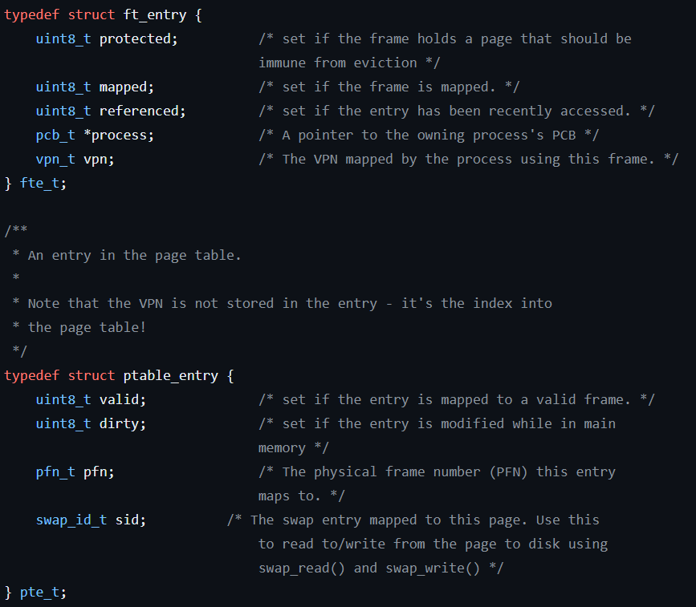
Oops!

Slide 118
Back to our pipelined processor
I₅
I₄
I₃
I₂
I₁
B
U
F
F
E
R
B
U
F
F
E
R
B
U
F
F
E
R
B
U
F
F
E
R
With virtual memory…
Every memory access requires two memory accesses!
PTE
Actual memory word
This is bad news for the pipeline
At least one bubble for every instruction
IF
ID/RR
EX
MEM
RW

Slide 119
Speeding up address translation
Virtual
Address
Physical
Address
CPU
VPN
Page offset
PFN
Page offset
Memory
PFN
The entire page table won't fit in registers
But a subset can!
What if we add a small table into this process?
Small
Table
Page table

Slide 120
Why will this work?
Virtual
Address
Physical
Address
CPU
VPN
Page offset
PFN
Page offset
Memory
PFN
Small
Table
The locality of a program
Sequential instructions
Contiguous data structures
The set of pages being referenced at a given time is called the Working Set
Page table

Slide 121
TLB (translation lookaside buffer)
It will look something like the following table
It is an associative memory, which means it can search on a match on the first two columns and output the corresponding last two columns in one cycle
USER/KERNEL | VPN | PFN | VALID/INVALID
U | 0 | 122 | V
U | XX | XX | I
U | 10 | 152 | V
U | 11 | 170 | V
K | 0 | 10 | V
K | 1 | 11 | V
K | 3 | 15 | V
K | XX | XX | I

Slide 122
Speeding up address translation
Virtual
Address
Physical
Address
CPU
VPN
Page offset
PFN
Page offset
Memory
PFN
The entire page table won't fit in registers
But a subset can!
What if we add a small table into this process?
Small
Table
Page table

Slide 123
Speeding up address translation
Virtual
Address
Physical
Address
CPU
VPN
Page offset
PFN
Page offset
Memory
TLB
A TLB hit
Fast path
No bubbles
PFN
Page table

Slide 124
Speeding up address translation
Virtual
Address
Physical
Address
CPU
VPN
Page offset
PFN
Page offset
Memory
TLB
A TLB miss
Slow path
Bubbles
PFN
Page table

Slide 125
TLB
USER/KERNEL | VPN | PFN | VALID/INVALID
U | 0 | 122 | V
U | XX | XX | I
U | 10 | 152 | V
U | 11 | 170 | V
K | 0 | 10 | V
K | 1 | 11 | V
K | 3 | 15 | V
K | XX | XX | I
I
I
I
I
Specific to each process
Same for all processes
What's the implication of the U entries for a context switch?
➔ We'll need to flush the U entries on context switch

Slide 126
Another new instruction
The LC-2200 is going to need
Purge TLB
or TLB flush
Who can execute this instruction?
It can only be executed by the kernel

Slide 127
Upon a context switch…
The entire TLB is flushed
Only the kernel portion of the TLB is flushed
Only the user portion of the TLB is flushed
No change to the TLB
Is class over yet?
Today’s number is 30,332
70

Slide 128
Given the nature of a process
CPU
I/O
We want to increase multiprogramming to keep the CPU busy doing useful work
This is what we want to see:
CPU utiliza-
tion
Degree of multiprogramming

Slide 129
Extending the utilization curve
CPU Utilization
Thrashing
What's going on here??
Nobody is getting any useful work done
Paging is implicit I/O on behalf of a process
→ System becomes I/O bound
→ Throughput drops precipitously
Too many processes asking for memory
This is overcommitment of memory
We have a bigger working set than physical memory can hold
CPU utiliza-
tion
Degree of multiprogramming

Slide 130
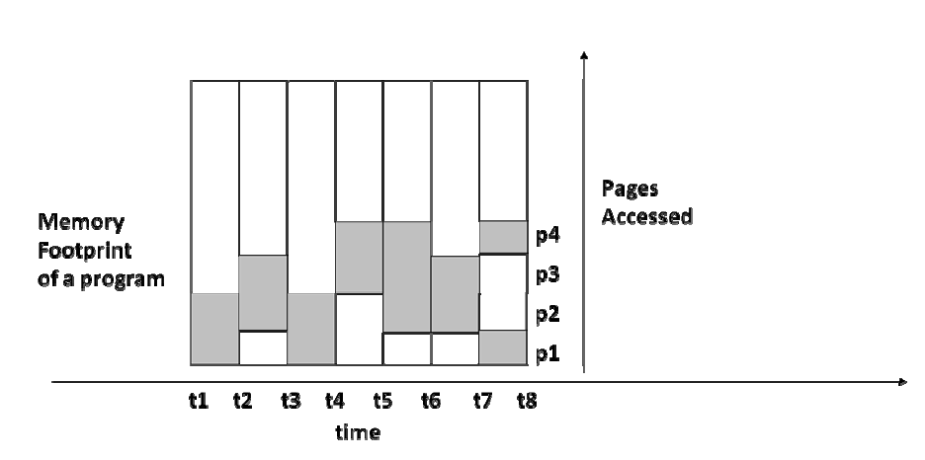
Working set of a program
Working set is the set of pages needed to keep a process from paging
Virtual page number (VPN)
Working set size: number of page frames needed to hold working set

Slide 131
Working set of a program
The working set changes over time
Virtual page number (VPN)
WS_{t3-t4} = { p1, p2 }
WS_{t7-t8}= { p4, p1 }

Slide 132
Memory pressure
P₁, P₂, P₃, … are processes in memory each with a working set WSS_{i}
The count of active processes signifies the degree of multiprogramming
How do we control the degree of multiprogramming
∑WSS > total physical memory
➔ swap out some processes
∑WSS < total physical memory
➔ increase degree of multiprogramming

Slide 133
Controlling thrashing
Page faults
Too many page faults
➔ lower mp
High water
mark
Sweet spot!
Low water
mark
Too few page faults
➔ raise mp
# physical frames per process

Slide 134
Page faults are disruptive…
… from a process point of view ➔ implicit I/O
… from a CPU-utilization perspective ➔ overhead that doesn’t contribute to work
We need to limit impact of page faults to improve system performance

Slide 135
We can tell a system is thrashing when
It has too few page faults per second
It has too many page faults per second
The ratio of I/O operations to CPU operations is not optimal
The combined working set of all processes is greater than the number of available page frames
If only it were as easy as B! Thrashing implies too many page faults, but too many page faults don’t always imply thrashing! Applications can be changing the pages in use without changing their working set size, for instance.
In RL, to diagnose thrashing, you’d look for a high paging rate, low CPU utilization, and several processes waiting on paging I/O for several seconds. Those metrics together are a good clue.
Today’s number is
81,818
80

Slide 136
We can reduce thrashing by
Using a medium-term scheduler that suspends processes until the condition improves
Reducing the physical memory size
Adding additional processes to increase the multiprogramming factor
Reducing the page size
Of course this begs the question of how the medium-term scheduler is going to figure out that the system is thrashing…
90

Slide 137
Optimizations
Keep a (small) pool of free frames
Overlap I/O with processing
Don’t wait to start page replacement algorithm on a page fault
Page replacement
Background activity of OS when CPU is not in use
If I/O is not busy, write out a “dirty” page which makes it “clean”
victim
Skip
(look for a clean one)
freelist
Dirty
Clean
Clean
Pframe 52
Pframe 22
Pframe 200
….

Slide 138
Reverse mapping to page table
Gives a “third” chance for reuse of a page before being kicked out
Record the PID and VPN when the page is put on the free list
Example: P4 is running and page faults on VPN=33
No need to go to disk!
Just remap PFN=52 into PT for P4, VPN=33 and take it out of the freelist
freelist
Dirty
Clean
Clean
Pframe 52
Pframe 22
Pframe 200
….
<P4, 33>
<P1, 12>
<P2, 43>

Slide 139
Linux VM and kswapd
$ free -h
total used free shared buffers cached
Mem: 15G 7.1G 8.5G 164K 703M 2.4G
…
-/+ buffers/cache: 4.0G 11G
Swap: 2.0G 26M 1.9G
Kswapd
Paging daemon
Runs when “free” memory is low (about 2% of memory)
Uses a modified version of second-chance replacement
Links victim pages into the free list and sets their “invalid” PTE bits, writing it out if it’s dirty
Page fault handler:
If the target page is still on the free list, it is reclaimed by removing it from the free list and marking its PTE bit “valid”
Otherwise, the first frame on the Free List is removed, the target page is read into it, and the target page’s PTE is modified to point to it and “valid” is set

Slide 140
Segmented virtual memory
Segmentation is a system allowing a process's memory space to be subdivided into chunks of memory each associated with some aspect of the overall program
Segmented virtual memory came first, ca. 1960, see Burroughs B5500.
Segmentation isn’t transparent like paging, but it is much more aware of program and data structures
It’s visible to the ISA, so it doesn’t work as a retrofit to ISAs with contiguous memory models. IBM couldn’t use it in the 1970s because they had already committed to upper/lower bound register memory management and a contiguous address space.
Hence, we have paging which could be transparently slipped under existing memory management. Other manufacturers followed suit because paging didn’t require their applications to be aware of paging.

Slide 141
Segmented virtual memory
Segmentation is a system allowing a process's memory space to be subdivided into chunks of memory each associated with some aspect of the overall program
Segments can be different sizes
Segmented virtual memory came first, but it’s visible to the ISA, so it doesn’t work as a retrofit to ISAs with contiguous memory models
Typical segments
Code segments (up to 1 per function)
Global data
Heap (perhaps arrays in separate segments)
Stack (perhaps arrays in separate segments)

Slide 142
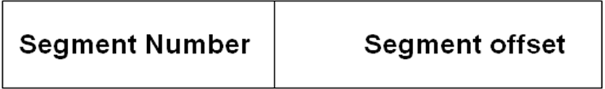
Segmented virtual memory
Process address space divided up into n distinct segments based on the program organization
Each segment has
A number
A size
Each segment starts at its own address 0 and goes up to its size – 1.
Segment addressing

Slide 143
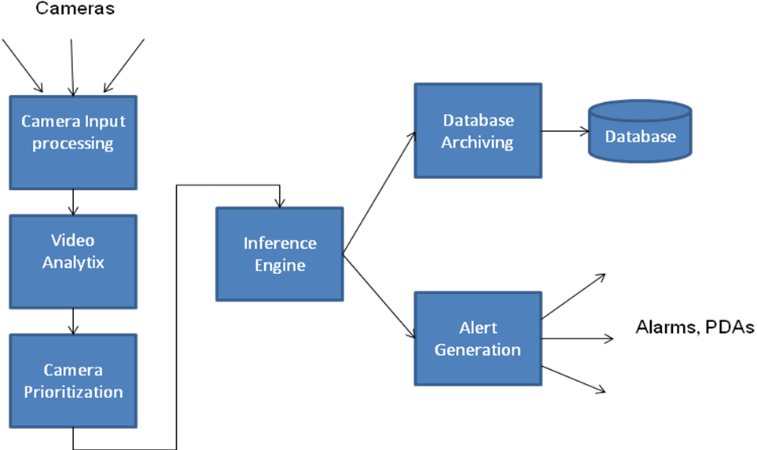
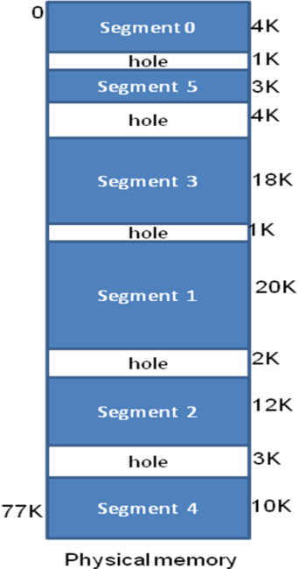
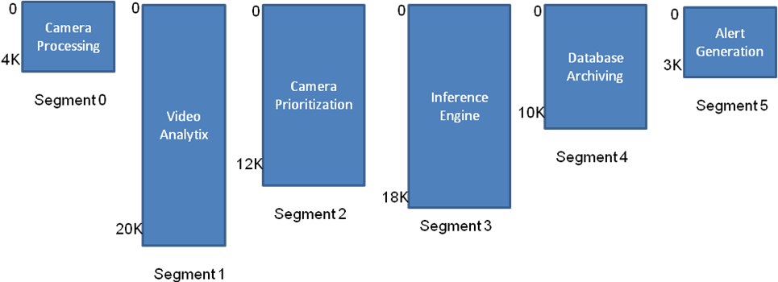
Segmented virtual memory example

Slide 144
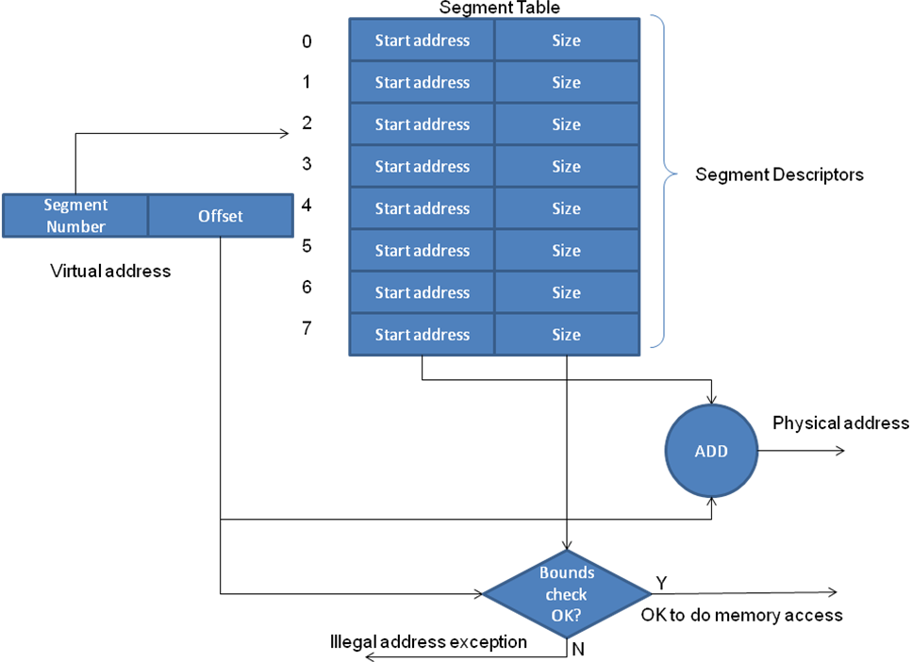
Hardware for segmentation
An opportunity for external fragmentation?
What’s different from paged virtual memory?

Slide 145
64-bit Virtual Addresses?
Page tables can be BIG and we need one for each process in memory
For example a 64-bit virtual address with 4KB pages means the VPN is 64 - 12 = 52 bits long.
If a page table entry is 64 bits, how much space does one use?
2⁵² entries* 2³ bytes = 2⁵⁵ bytes = 2¹⁵ * 2⁴⁰ bytes
= 32768 Terabytes(!)
And we still need one for each process!
Is there a problem here?

Slide 146
Paged segmentation
Virtual Address
Segment number
Page number
Offset
S
P
W
Segment Descriptor
Table
Descriptor base register
Segment descriptor
Descriptor for s
S
Page Table for p
Segment descriptor
PT base for s
PTE
Segment descriptor
Limit
P
PTE
Virtual Page
Intel x86-64 uses a scheme like this (but with 4 levels and all tables having 512 entries)
So did MULTICS in the 70s
Segment descriptor
PTE for p
Segment descriptor
PTE
W
Segment descriptor
Segment descriptor
Segment descriptor

Slide 147
64-bit Physical Addresses?
How many bytes can you address with 64 bits?
Obviously, 2⁶⁴, right? Which is how big?
1.84 x 10¹⁹ or 1,840 followed by 15 zeros. That’s 1,840,000 terabytes or 1.84 exabytes
Largest Intel/AMD memory supported today is 16 TB
Do we need all 64 physical address bits?
48 bits (2⁴⁸) will get us 281 TB. That should be enough for current chips to become obsolete.

Slide 148
Intel’s X86-64 4-layer Page Tables

Slide 149
Which of these is False?
Variable length partitions have internal but no external fragmentation
Paged memory systems have internal but no external fragmentation
Segmented memory systems have external but no internal fragmentation
Paged segmented memory systems have internal but no external fragmentation
100

